Slide 1

Feature scaling and techniques in machine learning
Presented by :-
Hrishikesh Deshpande
ADS

Slide 2
What is feature scaling ?
This is one of the most important data processing step in machine learning.
We use mainly this concept of feature scaling in the algorithms where uses the concept of Distance and Gradient Descent.
This algorithms compute distance between features which are biased for numerically larger values if the data is not scaled.
Like ,if we don’t apply feature scaling on unscaled data then training will not perfect.
Also, Feature Scaling helps ML, DL algorithms to train and coverage faster for prediction.

Slide 3
Example for feature scaling
One feature is in whole KMs other in Mtrs and another one is in CM^2, so how we can use these features as they vary vastly.
This is where concept of feature scaling used.
Firstly, we scale our data before applying distance algo. on them so, that all features contribute equally to the result.

Slide 4
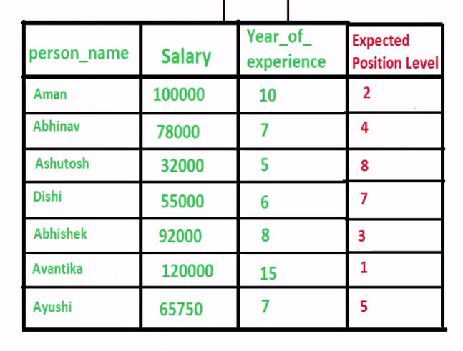
Our model should not take priority for salary over experience feature. so….

Slide 5
Algorithms used for feature scaling :
We use algorithms for feature scaling like :-
1. KNN
2. K means clustering
3. Deep learning based algorithms.

Slide 6
Techniques in feature scaling :
There are two techniques used in feature scaling :-
1. Normalization / Min-Max scaling :
2. Standardization / Z score normalization :

Slide 7
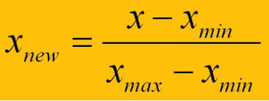
Normalization / min-max scaling :
It mainly helps down feature in range between o and 1.
Here, new point is calculated as,
Formula :
Scale ranges between 0 to 1. and also called as Min – Max scalar.
This technique used in classification problem.
It is required where attributes are on a different scale. When multiple attributes are there and have on different and big scale, it will lead in poor data model. So, they normalized this to bring all attributes / features on same scale.

Slide 8
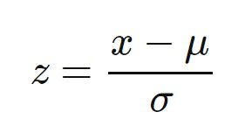
Standardization / z score normalization :
This is transformation of features by subtracting from mean and dividing it by standard deviation. This also called as Z-score.
It also helps to scale down features based on standard normal distribution.
But, here it ranges in negative values also. So we cannot define range here.
Formula :
where, z= new data point , x = column value , next mean and standard deviation.
So, basically it is a scaling technique where values are centered around mean with a standard deviation. So, after scaling down features , mean of attributes becomes zero and resultant distribution has a standard deviation with value 1.

Slide 9
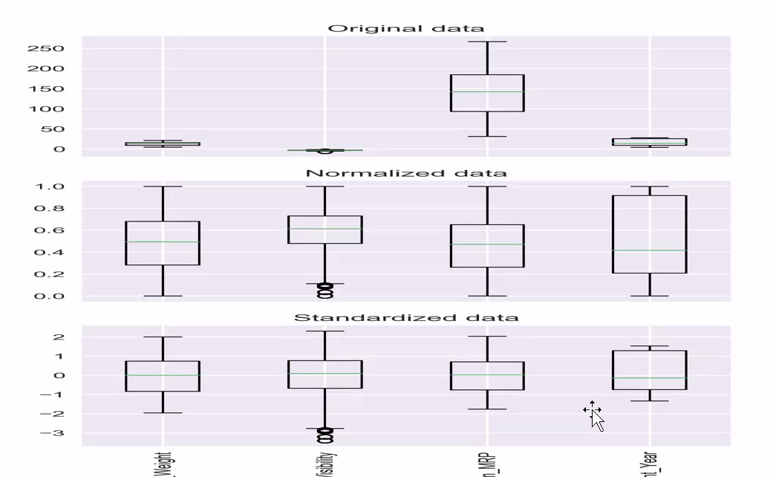
Difference between original, normalized and standardized data :

Slide 10
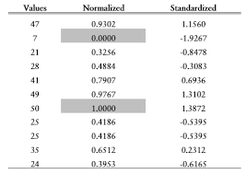
Data after get normalized and standardized :

Slide 11
Thank you…

